Slide 1
JUMBLE WORD GAME
MAKES LEARNING SPELLING FUN

Slide 2
SUBJECT:- FOUNDATIONS OF AI APPLICATIONS LAB
SUBJECT CODE:- 20ECP-118
MADE BY:
Kunal Garg(20BCS6714)
Amisha Khanna (20BCS6712)
Hritvik Mathur (20BCS6760)
Rivi Vig(20BCS6724)
Nishant Chaudhary (20BCS6726)

Slide 3
RULES OF THE GAME : 1. Five Rounds will be played and if you get 3 or more points , You won otherwise Computer Wins.
2. Use Capital Letters.
3. In each round, You will be given one Jumbled word and you have to answer the original unjumbled word.
4. If you answer is correct you get 1 point.

Slide 4
LIBRARY USED
Random Library
Numpy
Pillow : pip install pillow
Matplotlib :pip install matplotlib
Import code in python
import random
import numpy as np
import matplotlib.pyplot as plt
from PIL import Image

Slide 5
FUNCTION DEFINED
def game():
x = 0
y = 0
for i in range(5):
a=(random.choice(words))
print("\nThe jumble is:", get_jumble_word(a))
guess=input("Enter your guess:")
if guess == a:
x=x+1
print("That's it! You guessed it!\n")
else:
y=y+1
print("You failed...")
print("Your score is: " + str(x))
print("Computer score is: " + str(y))
if(x>y):
print("You Won")
plt.imshow(ImageNumpyFormat)
plt.draw()
plt.pause(1) # pause how many seconds
plt.close()
else:
print("You Lose")
play = input("Do you want to play again? (yes or no)")
if (play == "yes"):
game()
def get_jumble_word(word):
l = list(word)
random.shuffle(l)
return ''.join(l)

Slide 6
FULL CODE
def game():
x = 0
y = 0
for i in range(5):
a=(random.choice(words))
print("\nThe jumble is:", get_jumble_word(a))
guess=input("Enter your guess:")
if guess == a:
x=x+1
print("That's it! You guessed it!\n")
else:
y=y+1
print("You failed...")
print("Your score is: " + str(x))
print("Computer score is: " + str(y))
if(x>y):
print("You Won")
plt.imshow(ImageNumpyFormat)
plt.draw()
plt.pause(1) # pause how many seconds
plt.close()
else:
print("You Lose")
play = input("Do you want to play again? (yes or no)")
if (play == "yes"):
game()
import random
import numpy as np
import matplotlib.pyplot as plt
from PIL import Image
ImageAddress = 'C:/Users/hritv/PycharmProjects/JumbleWord/Youwon.png'
ImageItself = Image.open(ImageAddress)
ImageNumpyFormat = np.asarray(ImageItself)
def get_jumble_word(word):
l = list(word)
random.shuffle(l)
return ''.join(l)
with open("Jumbletxt.txt", "r") as file:
allText = file.read()
words = list(map(str, allText.split()))
print("""RULES OF THE GAME:
1. 5 Round will be played and if you get 3 or more points , You won otherwise Computer Wins.
2. Use Capital Letters.
3. In each round, You will be given one Jumbled word and you have to answer the original unjumbled word.
4. If you answer is correct you get 1 point.
""")
play = input("Do you want to play? (yes or no)\n")
if (play == "yes"):
game()
print("Thanks for playing.")
input("\nPress the enter key to exit.")

Slide 7
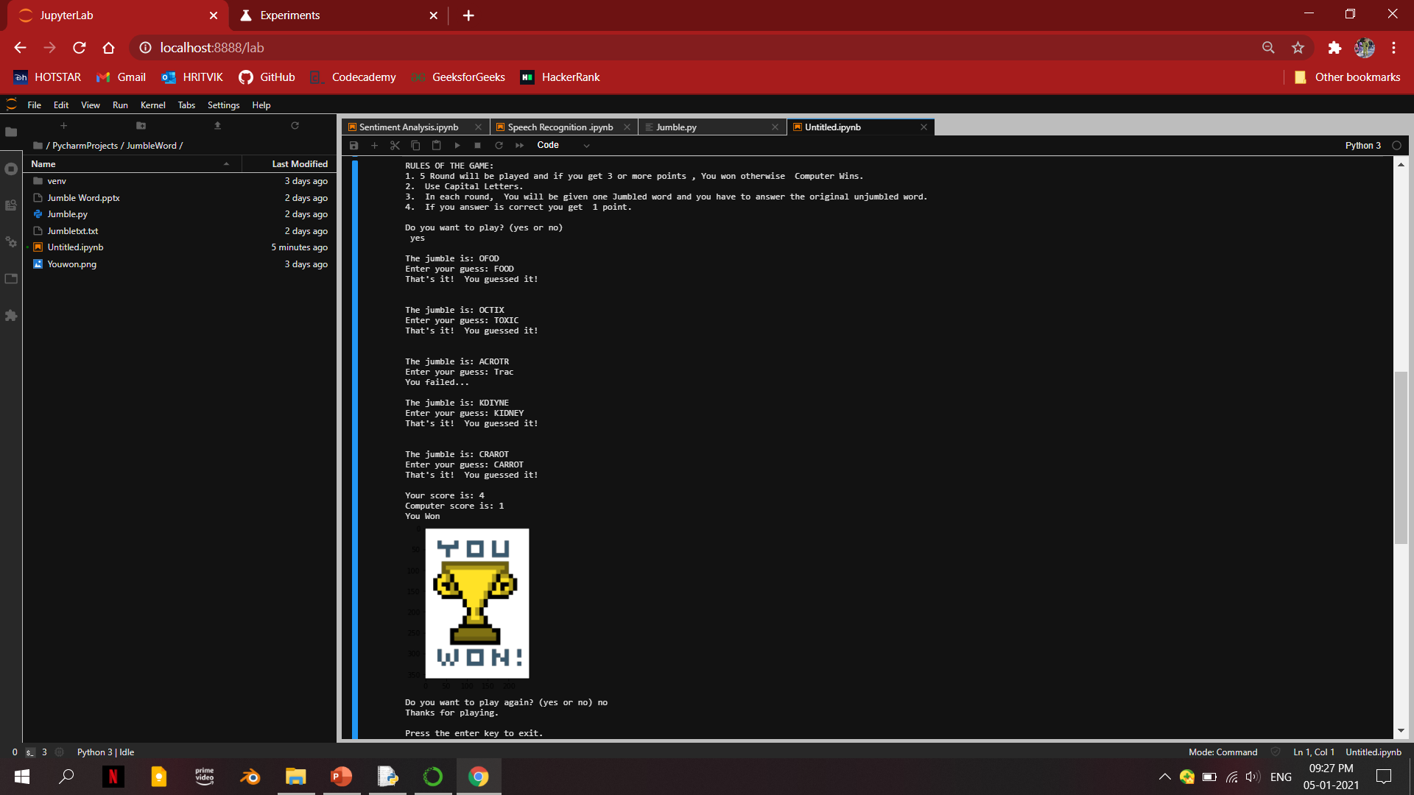
OUTPUT

Slide 8
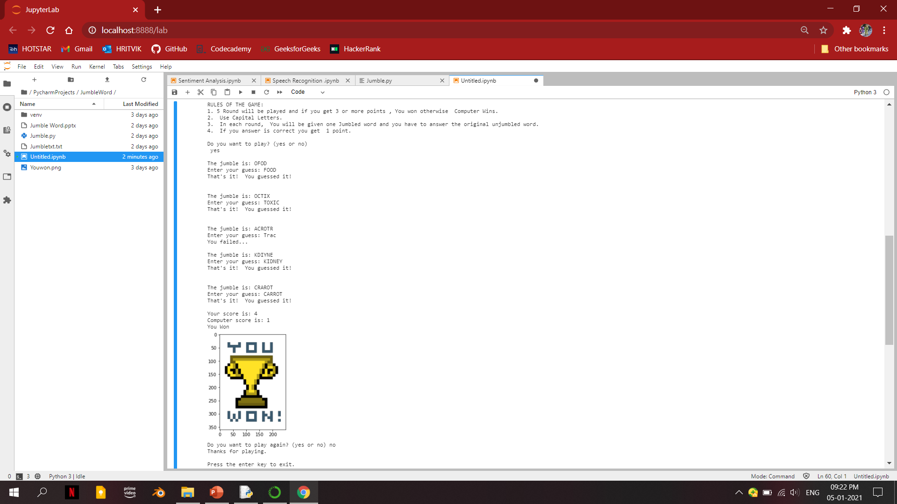
OUTPUT

